Slide 1
Chapter 12
Contractual Aspects of
Marriage & Divorce
Law in Society
Ms. Baumgartner

Slide 2
12-1 Marriage & the law of contracts
Discuss how the law affects premarital relationships
Explain how a marriage contract is formed and legalized
Name the rights and duties of husbands and wives

Slide 3
Premarital Relationships & the Law
Marriage – a legal union of a man and a woman as husband and wife
There are no laws that specify an age for dating
Typically the minimum age for marriage without parental permission is 18

Slide 4
Premarital Relationships & the Law
If 2 are dating and pregnancy results, the male is responsible to contribute to the child’s support
No law exists to force the parents of an illegitimate child to marry
A man and woman who live together outside of marriage are said to cohabitate
Cohabitation is illegal in some states, but is rarely enforced

Slide 5
Read GLOBAL ISSUES pg 207
What is an arranged marriage?
What is a dowry?
What is polygamy?
What are 2 examples of muslim countries?

Slide 6
The Marital Contract
If 1 party in a relationship proposes marriage and the other accepts, a binding contract results
If both later mutually agree to end their engagement, the contract is annulled – the law considers their agreement void and never to have existed

Slide 7
The Marital Contract
If only 1 party wants out of the contract and refuses to perform, a breach-of-promise suit may be brought by the other party
  Sue for costs associated with wedding
If the engagement ends, the courts usually order the ring to be returned. However, some states allow the woman to keep the ring if the man calls off the wedding.

Slide 8
The Marital Contract
Each state has different marriage laws
  Couples may have to apply for and pay a fee for a marriage license
  Couples may be required to do a blood test to show applicants are free from various diseases

Slide 9
Alabama Laws
    Must wait 60 days to remarry after a divorce
    No blood test
    Can marry cousins ☺
    No proxy marriages
    Can have common law marriage
    Must be 18 years old without parental consent
    Cannot marry under the age of 16
    No same sex marriages (marriage is not even recognized if ceremony was performed in another state)

Slide 10
The Marital Contract
There are 2 alternatives to marriage:
  Common-law marriages – marital relationship legalized by a couple acting as husband and wife, sharing home and property for an extended period
  Civil union – typically offers many of the rights, duties, and benefits as marriage to those who elect to form it
    In some areas, this has been known as a same-sex marriage
    It is open to opposite-sex couples in many states

Slide 11
Marital Rights & Duties
Traditionally, the law sees husband and wife as parties to a marriage contract for life and for the benefit of each other
The practical and legally recognized purposes for marriage are procreation, raising children, and filling sexual, economic, and companionship needs
The law recognizes these purposes as mutual duties of the wife and husband and calls them the marital consortium

Slide 12
Marital Rights & Duties
The most important duty of spouses is to provide for the support, nurture, welfare, and education of their children
Parents are obligated by state laws to support their children until they reach adulthood
Financial support of a couple’s children is a joint obligation!!!
Both parents have custody rights and have an equal voice in how to raise the children

Slide 13
Marital Rights & Duties
Sometimes, spouses bring property into marriage that they want to keep in their own names
They don’t want the other spouse to have claim over it, especially in the event of death or divorce
Keeping a spouse from getting rights in such property can be accomplished with a prenuptial agreement
  Read What’s Your Verdict on page 210

Slide 14
Assignment
12-1 Assessment
  #s on assignment sheet

Slide 15
12-2 divorce & the law of contracts
Discuss the ways by which a marriage can end
Explain the divorce procedure

Slide 16
Nullifying the Marriage Contract
A marriage may end several ways:
  Death of a spouse
  Annulment – legal procedure for declaring that a voidable marriage is null and void
    A voidable marriage results from a problem that existed from the beginning of the marriage
    Refusal to have children
    Lying about wealth, pregnancy, disease, age
  Divorce

Slide 17
Nullifying the Marriage Contract
  A void marriage creates no rights or duties for either party and is considered invalid from the beginning
    1 partner is already married when the 2nd marriage occurs (divorce isn’t final)
    A person who knowingly marries a second spouse while still married to the first is a bigamist
    Incestuous marriage
    Mental incompetence

Slide 18
Terminating the Marriage Contract
The method usually used to end a marriage is divorce
In some states the termination of marriage is called dissolution
Divorce and dissolution are court actions that end the marriage and divide the property and remaining responsibilities between the parties

Slide 19
Terminating the Marriage Contract
The United States has the highest divorce rate in countries around the world
Divorce rate for first marriage: 50%
Divorce rate for second marriage: 67%
Divorce rate for third marriage: 74%

Slide 20
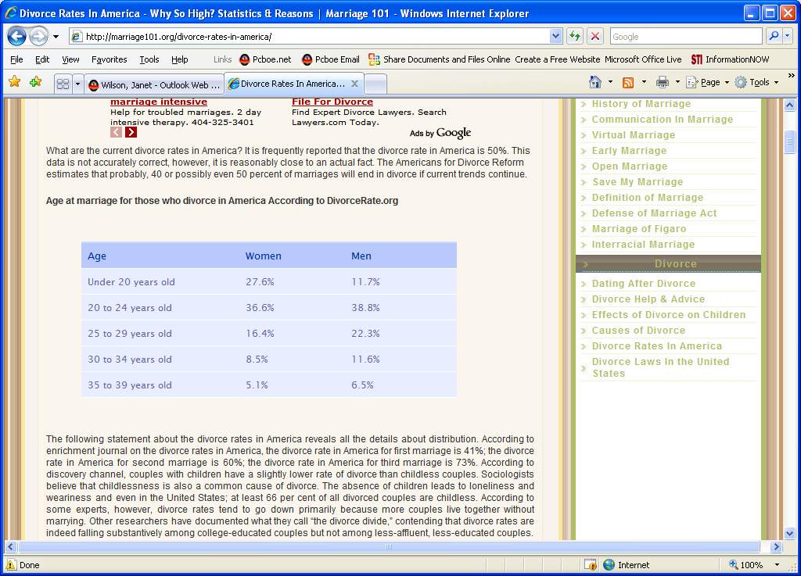
Terminating the Marriage Contract

Slide 21
Terminating the Marriage Contract
No-fault divorce – divorce procedure in which no cause need be shown for termination of the union
Both spouses mutually agree to the divorce

Slide 22
Terminating the Marriage Contract
Divorce procedures (varies by state):
  Separation – the spouses maintain separate living quarters, but their marital rights/obligations remain intact
  Counseling
  Resolution of issues
    Division of property
    Child custody and support
    Alimony
  Issuance of decree of dissolution of marriage – court issues order that marriage is OVER

Slide 23
Terminating the Marriage Contract
Child custody –the division of the physical and other care and control of responsibilities for a child
Child support – monetary payment by a parent to provide a dependent child with appropriate economic maintenance
Alimony – the support paid by the wage earner of the family to the other spouse

Slide 24

Assignment
Chapter 12-2 Assessment
  #s on assignment sheet

